Slide 1
ODE 4 – Stiff Equations and Multistep Methods
AMSC/CMSC 460
Dr. Christopher Moakler

Slide 2
Modeling Physical Phenomena
Last lecture, we looked at solving ODEs that model physical phenomena.
Some of these phenomena were pendula and planets orbiting around stars.
One of the issues we ran into when solving systems of this sort is that energy must be conserved as we forward integrate.
The methods we had been using do NOT conserve energy necessarily.
We had not yet encountered this issue because not all systems have an energy that needs conserving.
However, when modeling things like particles in a box, pendula, etc. the energy must remain constant or the system stops being physical.
We can overcome much of the issue if we use a Symplectic integrator like Velocity Verlet.

Slide 3
Stiffness
Another issue we haven’t discussed yet is the issue of stiffness.
Stiffness is a notoriously difficult term to define.
The general problem is that we sometimes try to integrate an ODE but find that we need a very small step size to get accurate solutions.
The small time step might even be required in regions where the function is relatively smooth.
This becomes an issue when the step size required for our desired accuracy necessitates an absurd number of time steps.
Let’s look at an example.

Slide 4
Stiff ODE Example
$$\dot{y}=−15y$$
https://commons.wikimedia.org/wiki/File:StiffEquationNumericalSolvers.svg

Slide 5
Stiffness Cont
Again, precisely defining stiffness is tricky.
If it is present in an ODE, it often means there are multiple time scales present in your problem.
Imagine a ODE whose solution has a large overarching shape with small fluctuations around it.
It’s not that methods like Forward Euler or RK4 can’t solve these methods.
We would just need very small time steps.
This makes it prohibitive to implement.
Let’s look at another example.

Slide 6
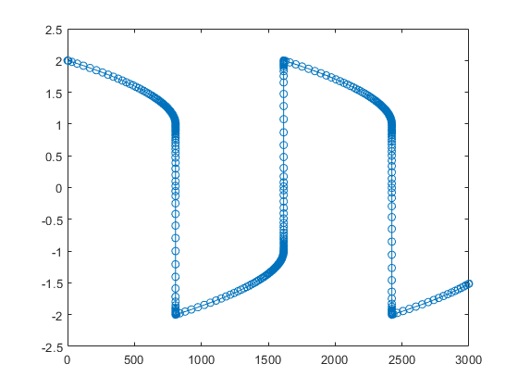
Another Stiff ODE Example
van der Pol equations
ode23s
ode45
Taken from Matlab Documentation

Slide 7
How to Solve a Stiff ODE Efficiently
Again, it’s not that our methods CAN’T solve these methods, they just do so very slowly.
We already have some effective tools to solve stiff ODEs in a reasonable amount of time.
The implicit methods we’ve looked at already will often tackle these problems much more efficiently.
Even a simple Backward Euler will fair much better than Forward Euler for a stiff problem.
These implicit methods often require more work per step, but can take many fewer steps.

Slide 8
An analogy from Cleve Moler (the guy behind Matlab)
Imagine you are returning from a hike in the mountains. You are in a narrow canyon with steep walls on either side. An explicit algorithm would sample the local gradient to find the descent direction. But following the gradient on either side of the trail will send you bouncing back and forth from wall to wall. You will eventually get home, but it will be long after dark before you arrive. An implicit algorithm would have you keep your eyes on the trail and anticipate where each step is taking you. It is well worth the extra concentration.

Slide 9
Multistep Methods
All of the methods we’ve looked at so far have been single-point methods.
That is, they only use information from the previous time-step to approximate the next time-step.
We can also devise methods that use more of the information we have at hand to hopefully get a better approximation.
Or at least do so using less computational effort.
Let’s look at one of the simpler multistep methods.

Slide 10
Adams-Bashforth Two-step Method
The update step for this method is given by
$$w_{i+1}=w_{i}+h\left(\frac{3}{2} f\left(t_{i},y_{i}\right)−\frac{1}{2}f\left(t_{i−1},y_{i−1}\right)\right)$$
This requires two evaluations of the derivative function at every time step.
However, we only need to evaluate the function at one NEW point at every step.
We have the value of $f\left(t_{i−1},y_{i−1}\right)$ from the previous update step.

Slide 11
Comparison between 2nd order Methods
Adams-Bashforth Two-step Method is a 2nd order method.
Compare this to the second-order Midpoint Method
$$w_{i+1}=w_{i}+hf\left(t_{i}+\frac{h}{2},w_{i}+\frac{h}{2}f\left(t_{i},y_{i}\right)\right)$$
This is also of second order but requires two new function evaluations at every time step.
In general, we can find multi-step methods of the same order as a single-point method that require less computational effort.

Slide 12
Getting started with a two-step method
The two-step method requires knowledge of the solution at two different points.
If we only have an initial condition, how can we get a second point so we can apply our two-step method?
We can use a one-step method to get an approximate value at an additional point.
In general, for an n-step method, we can use a one-step method to generate the required $n−1$ points.

Slide 13
A general n-step method
The general form of an n-step method is
$$w_{i+1}=a_{i}w_{i}+a_{2}w_{i−1}+…+a_{n}w_{i−n+1}+h\left(b_{0}f_{i+1}+b_{i}f_{i}+…+b_{n}f_{i−n+1}\right)$$
where $f_{i}=f\left(t_{i},w_{i}\right)$.
Notice that if $b_{0}≠0,$ we have an implicit method.
If not, then we have an explicit method.
We can write out the Taylor expansion of the function and identify the coefficients of the expansion with the coefficients of our n-step method.
Doing so yields,
$$w_{i+1}=\left(a_{1}+a_{2}\right)y_{i}+\left(b_{0}+b_{1}+b_{2}−a_{2}\right)h{\dot{y}}_{i}+\left(a_{2}−2b_{2}+2b_{0}\right)\frac{h^{2}}{2}{\ddot{y}}_{i}+…$$

Slide 14
A general n-step method cont
We can choose the coefficients $a_{i}$ and $b_{i}$ to minimize the local truncation error $y_{i+1}−w_{i+1}$.
Remember,
$$y_{i+1}=y_{i}+h{\dot{y}}_{i}+\frac{h^{2}}{2}{\ddot{y}}_{i}+…$$
To generate a $p^{th}$ order method, we equate the corresponding terms of the $w_{i+1}$ and $y_{i+1}$ equations.
This way, we can also get the local truncation error.
Let’s look at an example.

Slide 15
Finding an explicit 2nd order 2-step method
Since we want an explicit method, we set$b_{0}=0.$
We then equate the coefficients of the terms in expressions for $w_{i+1}$ and $y_{i+1}$ up to and including the $h^{2}$ term.
Doing so gives us the system,
$a_{1}+a_{2}=1$
$${−a}_{2}+b_{1}+b_{2}=1$$
$$a_{2}−b_{2}=1$$
How many unknowns are there?
We are free to choose one of these values arbitrarily and get a 2nd order method.
The local truncation error will be of 3rd order, but the global error will be of 2nd order.

Slide 16
Different options
If we had chosen $a_{1}=1$, we get the Adams-Bashforth Method from before.
If we choose $a_{1}=−1$, we get a different method,
$$w_{i+1}=−w_{i}+2w_{i−1}+h\left(\frac{5}{2}f_{i}+\frac{1}{2}f_{i−1}\right)$$
Let’s look at a comparison of these two methods.

Slide 17
Instability in Multi-step methods
$$a_{0}=1$$
$$a_{0}=−1$$
$$h=0.05$$
Sauer

Slide 18
Ensuring Stability
We see that not all 2nd order methods have the same stability regions.
This shouldn’t be entirely surprising, we’ve seen something similar with first order one-step methods.
Let’s look at a simpler example,
$$\dot{y}=0$$
$$y_{0}=1$$
$$0≤t≤1$$
If we use the $a_{1}=−1$ method, we get the update step,
$$w_{i+1}=−w_{i}+2w_{i−1}$$
From here we can form the “characteristic polynomial” by substituting in $w_{i}=cλ^{i}$.

Slide 19
Characteristic Polynomial
This leads us to,
$$cλ^{i+1}+cλ^{i}−2cλ^{i−1}=0$$
$$cλ^{i−1}\left(λ^{2}+λ−2\right)=0$$
This has roots of 1 and -2.
The latter root can cause issues.
Solutions of the form ${\left(−2\right)}^{i}c$ can quickly diverge.
Even small rounding errors can quickly blow up for us.
A multi-step method is stable only if the roots of characteristic polynomial are bounded in absolute value by 1.
A stable method is strongly stable if 1 is the only root of absolute value 1 and weakly stable otherwise.

Slide 20
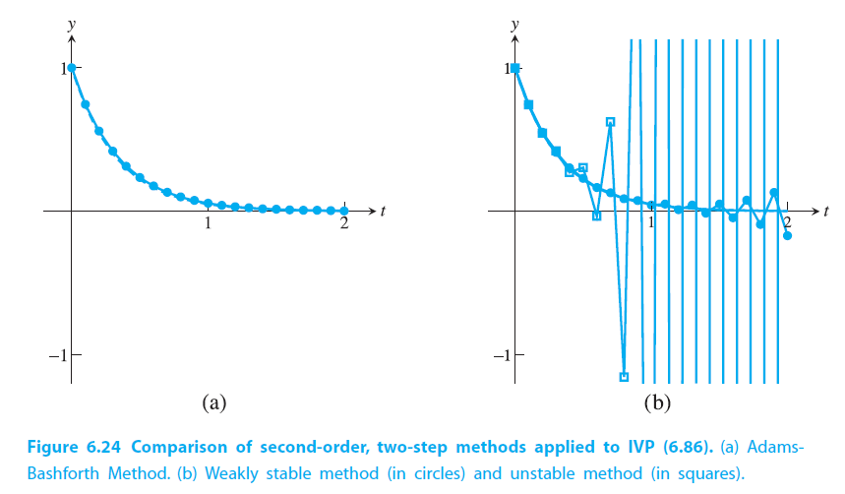
Stable, Weakly Stable, and Unstable
Sauer

Slide 21
Consistency, Convergence, and Stability
A numerical ODE integrator is consistent if it is of at least 1st order.
A numerical ODE integrator is convergent if the approximated solution converges to the exact solution as the step size drops to 0.
Dahlquist Equivalence Theorem – A multi-step method is convergent if and only if it is stable and consistent.
A single-step method is also convergent if it is stable and consistent.
To determine convergence we looked a the problem slightly differently for single-step methods.

Slide 22
Other Explicit Multi-Step Methods
Adams-Bashforth Three-Step Method
$$w_{i+1}=w_{i}+\frac{h}{12}\left(23f_{i}−16f_{i−1}+5f_{i−2}\right)$$
this is a third order method.
Adams-Bashforth Four-Step Method
$$w_{i+1}=w_{i}+\frac{h}{24}\left(55f_{i}−59f_{i−1}+37f_{i−2}−9f_{i−3}\right)$$
this is a fourth order method.
This fourth order method is the most popular of these methods.
It’s a fourth order method that only requires one new function evaluation at every step.

Slide 23
Implicit Multistep Methods
If we choose$b_{0}≠0$ we get implicit methods.
Here are some examples,
Adams-Moulton Two-Step Method
$$w_{i+1}=w_{i}+\frac{h}{12}\left(5f_{i+1}+8f_{i}−f_{i−1}\right)$$
a third order method.
Adams-Moulton Three-Step Method
$$w_{i+1}=w_{i}+\frac{h}{24}\left(9f_{i+1}+19f_{i}−{5f}_{i−1}+f_{i−2}\right)$$
a fourth order method.
Adams-Moulton Four-Step Method
$$w_{i+1}=w_{i}+\frac{h}{720}\left(251f_{i+1}+646f_{i}−{264f}_{i−1}+{106f}_{i−2}−19f_{i−3}\right)$$
a fifth order method.

Slide 24
When to use multipoint-methods
The multi-step methods are excellent for smoothly varying ODEs.
They have an exceptionally high order of convergence for relatively little computational effort.
However, if your ODE is not smoothly varying, you should instead use one of the single-point method we discussed.
These allow you to quickly recognize changes in your solution and get a better approximation.
A multi-step method will require several steps to actually reflect the change in the solution.
If your ODE is smoothly varying though, you should probably use the Adams-Bashforth Four-Step Method

Slide 25
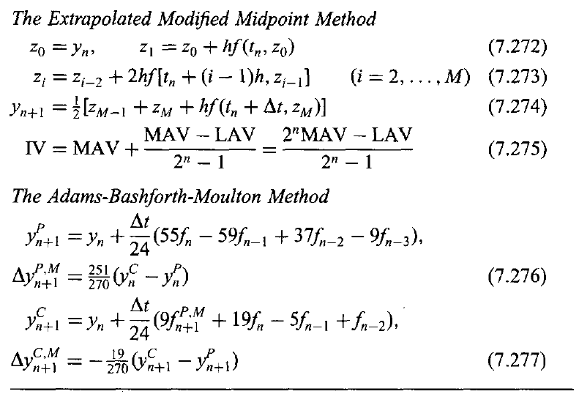
Summary of IVP ODEs
Hoffman

Slide 26
Summary cont
There are countless options for numerical ODE IVP solvers.
Which one you apply depends heavily on what you’re trying to do.
If you’re modeling a physical system where energy needs to be conserved, you should use a symplectic integrator like Verlet methods.
If you have a simple linear ODE, you will typically use RK4 at least as a first attempt.
To get better performance, you might consider an adaptive step size method like Dormand-Prince 4/5.
If you have a stiff system, you should use an implicit method like the implicit trapezoid method.
If you know the solution of your ODE is slowly varying, try a multi-step method.

